Slide 1
Learning and Performance Management

Slide 2
Learning
What is learning?
Learning is a relatively permanent change in behavior acquired through practice or experience
Two ways to initiate learning:
Give knowledge that leads to change
Alter consequences of behavior
LECTURE 6: Learning ∙ Goals ∙ Feedback ∙ Appraisal

Slide 3
Learning
When studying learning in terms of behavior, conditioning is a commonly used theory:
Classical conditioning modifies behavior by pairing an unconditioned stimulus with a conditioned stimulus in order to elicit an unconditioned response
Operant conditioning modified behavior by following it with positive or negative consequences
Which is more useful in organizations?
LECTURE 6: Learning ∙ Goals ∙ Feedback ∙ Appraisal
Notes:
Organizations use operant conditions
Pavlov's dogs classical conditioning

Slide 4
Learning
Operant conditioning proposes that behavior can be modified by changing its consequences
Three components of operant conditioning:
A stimulus in the environment cues attention to a behavior
Behavior occurs in response to a stimulus
Outcomes are the consequences of our behavior
LECTURE 6: Learning ∙ Goals ∙ Feedback ∙ Appraisal

Slide 5
Learning
Reinforcement: Enhance desirable behavior by giving positive consequences, or withholding negative ones
Examples of positive reinforcers?
Negative reinforcers?
LECTURE 6: Learning ∙ Goals ∙ Feedback ∙ Appraisal
Notes:
Reinforcers – thanking employee for being on time
Giving pay increases, promotions praise
Probationary periods, removal from negative situation, e.g. reassign

Slide 6
Learning
Punishment: Discourage undesirable behaviors by giving negative consequences or withholding positive consequences
Extinction: Attaching no consequence to an undesired behavior; this may be the most effective when used alongside positive reinforcement (for desired behaviors)
LECTURE 6: Learning ∙ Goals ∙ Feedback ∙ Appraisal
Notes:
6

Slide 7
Learning
Positive reinforcement
(give positive consequences)
Desired behaviors
Negative reinforcement
(withhold negative consequences)
Antecedents
(info about behaviors and consequences)
Extinction
(give/withhold no consequences)
Undesired behaviors
Punishment
(give negative consequences or withhold positive consequences)
LECTURE 6: Learning ∙ Goals ∙ Feedback ∙ Appraisal
Notes:
Negative reinforcement – removing a negative effect
Positive punishment – adding a bad thing – net loss
Extinction – ignore the behavior – only works if the person needs you

Slide 8
Learning
Social learning theory asserts that people observe others, and model their behavior accordingly; learning is enhanced when learners have high task-specific self-efficacy
What are the sources of self-efficacy?
Successful past performance
Vicarious experience
Verbal persuasion (coaching, displaying confidence)
LECTURE 6: Learning ∙ Goals ∙ Feedback ∙ Appraisal
Notes:
One more bullet
Experiencing psychologically calm or arousing states
Social learning work when the person who is modeling the behavior is like the person to be trained

Slide 9
Performance Management
Performance management is a set of processes and managerial behaviors that include defining, monitoring, evaluating, and providing consequences for performance expectations
Through performance management, we can regulate what employees learn and direct that learning towards completing job tasks
LECTURE 6: Learning ∙ Goals ∙ Feedback ∙ Appraisal
Notes:
9

Slide 10
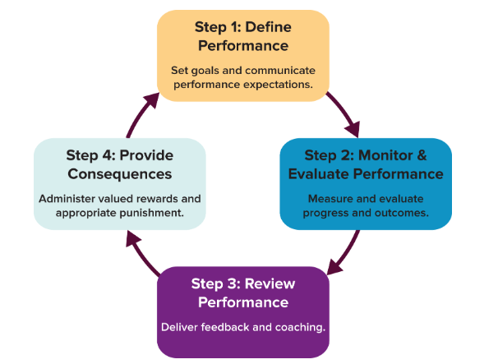
Performance Management
LECTURE 6: Learning ∙ Goals ∙ Feedback ∙ Appraisal

Slide 11
Performance Management What is Job Performance?
There are two general categories of performance behavior:
Task performance: Work-related tasks/goals (e.g., financial goals, administrative tasks, production, etc.)
Contextual performance: Support the social environment (e.g., helping, cooperating, providing social support) – organizational citizenship behavior
While task performance is often clearly defined, contextual performance is typically discretionary and not a mandatory part of an employee’s job
LECTURE 6: Learning ∙ Goals ∙ Feedback ∙ Appraisal

Slide 12
Performance Management Defining Performance Goals
Goal-setting is the process of establishing desired results that guide and direct behavior
Goals affect performance through four routes:
Directing attention towards goal-relevant activities
Energizing people towards activity and behavior
Encouraging persistence when possible
Eliciting the use or learning (when needed) of task-relevant knowledge and strategies
LECTURE 6: Learning ∙ Goals ∙ Feedback ∙ Appraisal

Slide 13
Performance Management Defining Performance Goals
Evidence on goal setting (Locke & Latham, 2002; Tubbs, 1986):
Difficult (but not impossible) and specific goals can enhance performance more than no goals or “do your best” goals, yet only if feedback is received throughout
Participative goal setting (vs. assigned goals) enhances performance if it causes a person to set difficult goals
Performance-based goals are less effective with complex tasks than are learning-based goals
LECTURE 6: Learning ∙ Goals ∙ Feedback ∙ Appraisal

Slide 14
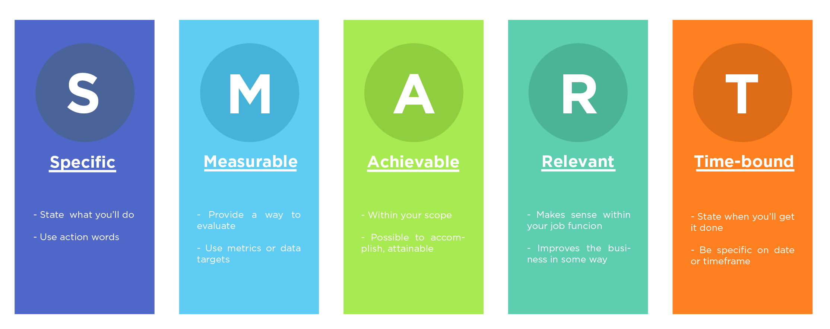
Performance Management Defining Performance Goals
LECTURE 6: Learning ∙ Goals ∙ Feedback ∙ Appraisal
Notes:
14

Slide 15
Performance Management Defining Performance Goals
Goal setting serves three major functions:
Increase work motivation and thus performance
Reduce role stress (e.g., task conflict, role ambiguity, job overload)
Improve accuracy and validity of performance evaluations
LECTURE 6: Learning ∙ Goals ∙ Feedback ∙ Appraisal

Slide 16
ACTIVITY
LECTURE 6: Learning ∙ Goals ∙ Feedback ∙ Appraisal

Slide 17
Performance Management Building Commitment to Goals
Goals not only need to be set, but employees need to feel committed to those goals; goal commitment enhances the motivating potential of goals
Commitment to goals can be enhanced by:
1 Highlighting the importance of the goal: making commitment public, validation and support from leaders, participative goal-setting, financial compensation
2 Boosting an employee’s goal-specific self-efficacy: Adequate training/development, role-modeling (social learning theory), persuasive/inspirational communication
LECTURE 6: Learning ∙ Goals ∙ Feedback ∙ Appraisal

Slide 18
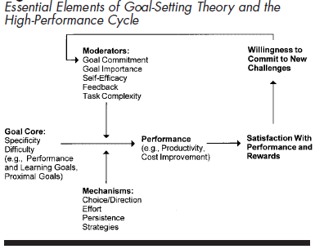
Performance Management Building Commitment to Goals
LECTURE 6: Learning ∙ Goals ∙ Feedback ∙ Appraisal

Slide 19
Performance Management Monitoring and Providing Feedback
Performance feedback is CRITICAL for motivating and improving performance; managers should:
Be specific and refer to incidents, facts, and observable behaviors
Focus on changeable behaviors
Plan the session ahead of time (give evaluations ahead of time to let employee prepare)
Balance positive with negative feedback
LECTURE 6: Learning ∙ Goals ∙ Feedback ∙ Appraisal

Slide 20
Performance Management Monitoring and Providing Feedback
Managers engage in a three step process to identify performance issues and correct them:
Identify the cause of poor performance
If internal/personal, determine source; if external, fix if possible
Develop correction plan
LECTURE 6: Learning ∙ Goals ∙ Feedback ∙ Appraisal

Slide 21
Performance Management Monitoring and Providing Feedback
Managers can attribute performance issues to either internal or external causes by collecting the following information:
Consistency: Does the behavior always occur?
Consensus: Does everyone else exhibit the behavior in that situation?
Distinctiveness: Does the person act that was in other situations?
LECTURE 6: Learning ∙ Goals ∙ Feedback ∙ Appraisal

Slide 22
Performance Management Monitoring and Providing Feedback
Internal causes can be attributed when behaviors are not distinctive, have low consensus, and highly consistent
Internal causes of poor performance may include:
Negative attitude towards boss (or company), personal life, lack of skill/ability
External causes may include:
Poor role design,
LECTURE 6: Learning ∙ Goals ∙ Feedback ∙ Appraisal

Slide 23
Performance Management Monitoring and Providing Feedback
LECTURE 6: Learning ∙ Goals ∙ Feedback ∙ Appraisal

Slide 24
Performance Management Formal Appraisals and Reviews
Performance appraisal is the evaluation of performance and serves many functions: providing feedback, setting developmental goals, deciding pay/promotions
LECTURE 6: Learning ∙ Goals ∙ Feedback ∙ Appraisal

Slide 25
Performance Management Formal Appraisals and Reviews
Good performance appraisals are valid (many parts of performance), reliable (multiple sources), responsive to employee input, flexible, and equitable (fair)
To better reinforce goals set during appraisals, managers can provide feedback regularly; if done consistently, this practice can help maintain employee motivation long-term
LECTURE 6: Learning ∙ Goals ∙ Feedback ∙ Appraisal

Slide 26
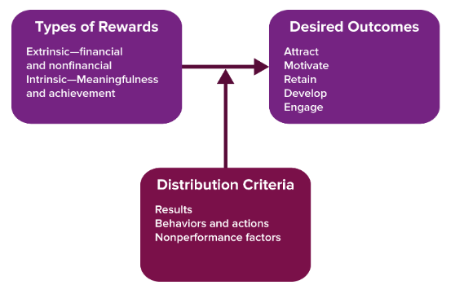
Performance Management Rewards and Consequences
LECTURE 6: Learning ∙ Goals ∙ Feedback ∙ Appraisal
Notes:
26

Slide 27
Performance Management Rewards and Consequences
Review the “Reinforcement and Consequences” chapter more closely on your own
LECTURE 6: Learning ∙ Goals ∙ Feedback ∙ Appraisal
Notes:
27

